Slide 1
Good Air Days: Ventilation in theatres to reduce SSIs
Peter Hoffman
Consultant Clinical Scientist
Antimicrobial Resistance and Healthcare-associated Infections Reference Unit

Slide 2
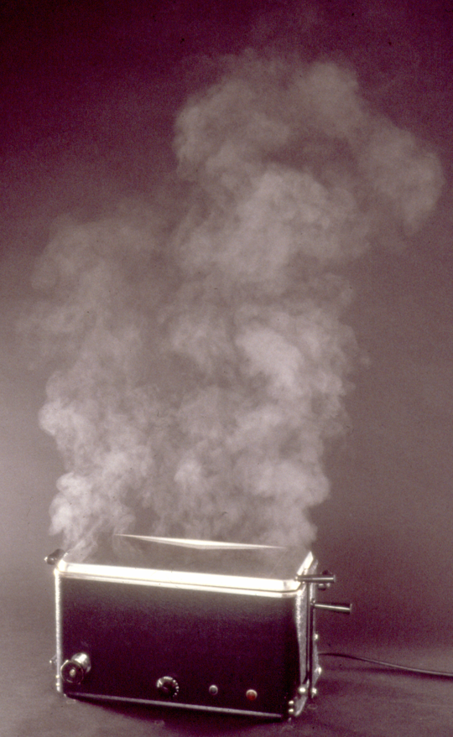
Where it all started
1950s – Instruments “sterilized” in boiling water in prep room adjoining theatre
Steam & heat removed by powerful extract fans
Air entered theatre suite from outside to replace that extracted air
2

Slide 3
Early theatre ventilation work
Shooter RA et al. Postoperative wound infection. Surg Gynec Obstet 1956; 103: 257-62.
Contaminated air was being drawn into a theatre from adjacent areas. When this inward flow was reversed “This was followed by an immediate reduction in the bacteria in the air and by a striking fall in the incidence of wound infections from 37 out of 427 clean operations to 5 out of 532”.
There are other, similar papers from that era.
3

Slide 4
Sources of airborne contamination in the theatre
Skin is constantly renewing itself.
Dried, dead skin cells (“squames”) will detach themselves from the skin.
These are around 5 – 15 microns (thousandths of a millimetre) and light enough to float through the air
Some of them will carry microcolonies of the bacteria that grow on the skin – range of 1 to 1,000 bacteria per microcolony
Dispersion from this source depends on the number of people in theatre and their degree of activity.
4

Slide 5
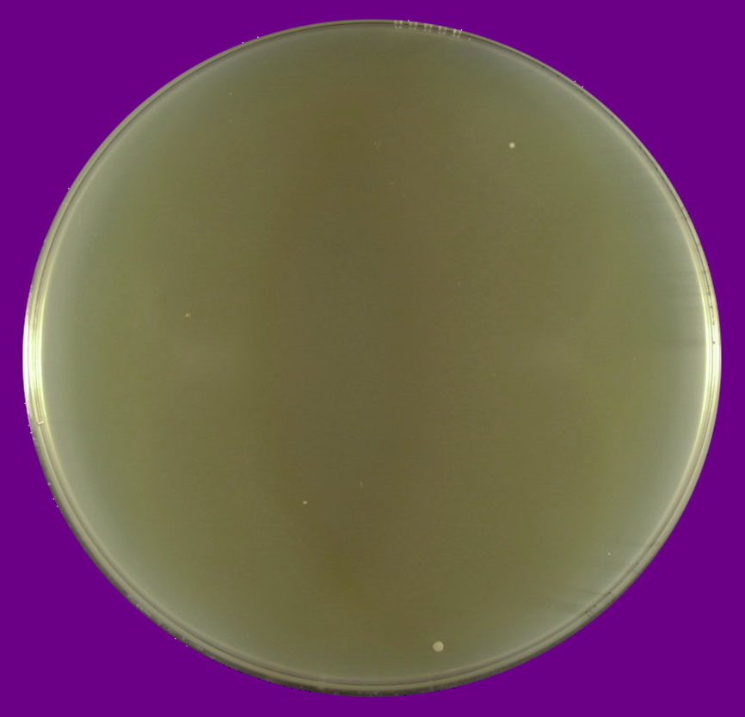
Empty room – 1,000 litres of air
5

Slide 6
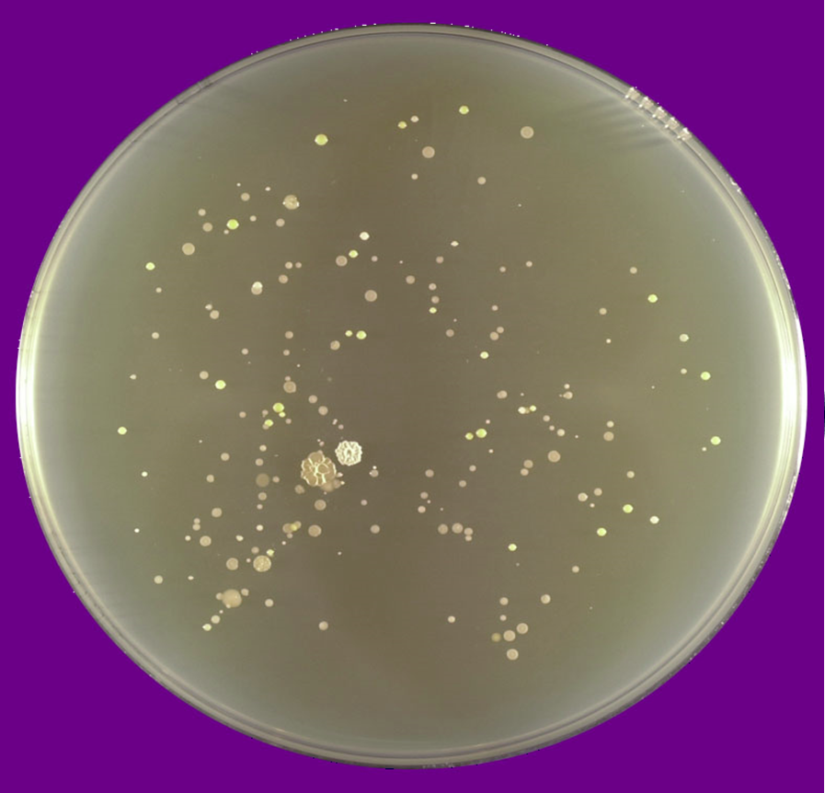
Same, but with me walking by sampler
6

Slide 7
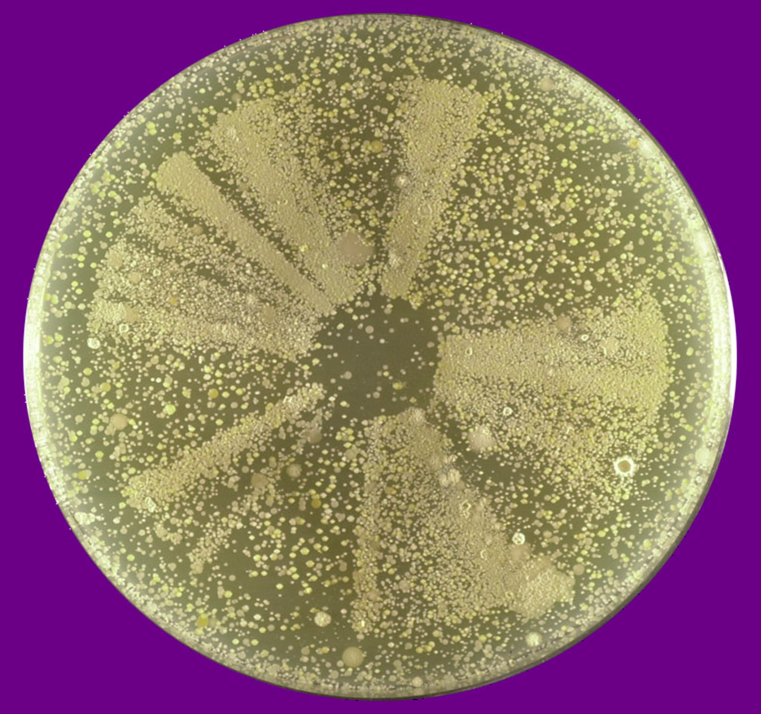
Using that sampler to vacuum my (clean on that morning) clothes
7

Slide 8
Purpose of theatre ventilation
To prevent bacteria from settling-out in "the wound".
8

Slide 9
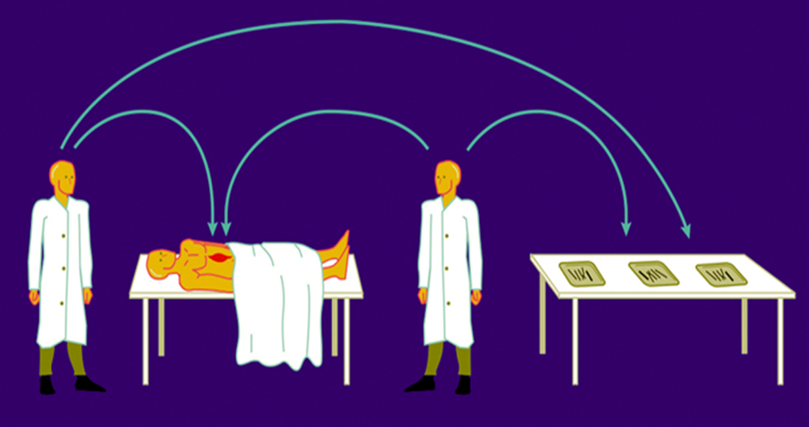
Pathways of airborne theatre wound contamination
The majority of airborne bacteria that end-up in a surgical wound usually get there via exposed instruments
9

Slide 10
Operating theatre ventilation strategy
Stop uncontrolled air entering suite from surrounding areas
Dilute contamination generated in operating and layup rooms
Do this by supplying lots of clean air to those rooms in the suite which you want to be the cleanest
Encourage it to flow out to less clean adjacent areas
This dilutes contamination in the clean rooms and, as air is flowing outwards via any gaps, stops air from surrounding areas flowing back in.
10

Slide 11
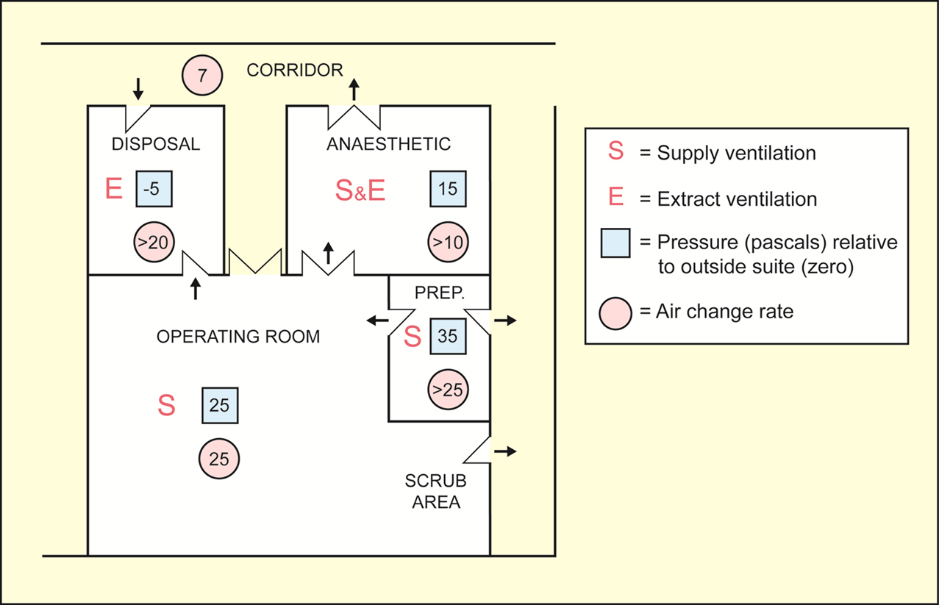
The detail – conventional theatre ventilation
11

Slide 12
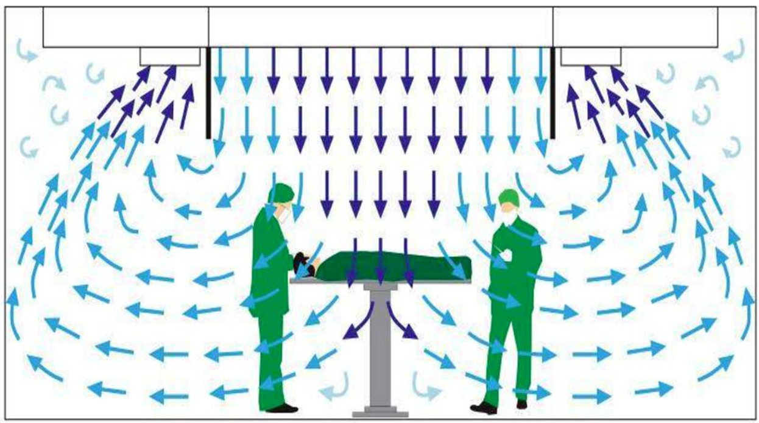
Another strategy: ultraclean ventilation (UCV), aka ‘laminar flow’
12

Slide 13
Routine air sampling in theatres?
Ventilation systems are stable and will not change dramatically
Replacing filters like-for-like will not affect their performance; the quality of air supplied will remain the same
There is sometimes a local tradition to take annual air samples as a routine check
This can be harmless. The problem comes with poorly taken samples generating false positives.
This process can be ceased without compromising patient safety.
If stopping it is too much of a headache, try to ensure those who take the samples know what they’re doing.
13

Slide 14
Air sampling after building work in theatres
There is a tradition in many hospitals that microbiology will be asked to do air sampling following building work in a theatre to verify adequate cleaning.
An air sample, properly taken, just shows the quality of air being supplied
Not the environmental cleanliness of the theatre
You can take an air sample in a visibly dirty theatre and have that air sample show satisfactory results
Again, a meaningless tradition. Abandon if not too painful a process. If can’t abandon, make sure the samples are properly taken.
14

Slide 15
Time to leave theatre after “infected” case?
Dilution is measured in terms of a theatre’s air change rate
One air change will reduce airborne contamination by 63% (i.e. to 37%) of it’s previous levels
Once an end to dispersion can be defined (i.e. the patient leaving the theatre)
Each subsequent air change will reduce it by a further 63%
15

Slide 16
Time to leave theatre after “infected” case?
Theatres should have 20 – 25 air changes per hour (air equivalent to 20 – 25 time the volume of the theatre being supplied each hour).
Air changes | Contamination left (%)
0 | 100
1 | 36.8
2 | 13.5
3 | 5
5 | 0.67
10 | 0.0046
20 | 0.0000002
If 20 air changes per hour: 5 air changes in 15 minutes, 10 air changes in 30 minutes.
16

Slide 17
Energy saving
Common practice to keep theatre ventilation on all the time “to stop contamination entering the theatre”
But:
If theatre ventilation off, air will be static – little air exchange with surrounding rooms
When a theatre is not in use, the major source of contamination (people) will not be present
Switching ventilation back on 15 – 30 minutes before use (see dilutions in previous slide) gives ample dilution of anything that might have come in.
Care not to allow ventilation to be turned off whilst theatre still in use (e.g. override linked to operating light).
17

Slide 18
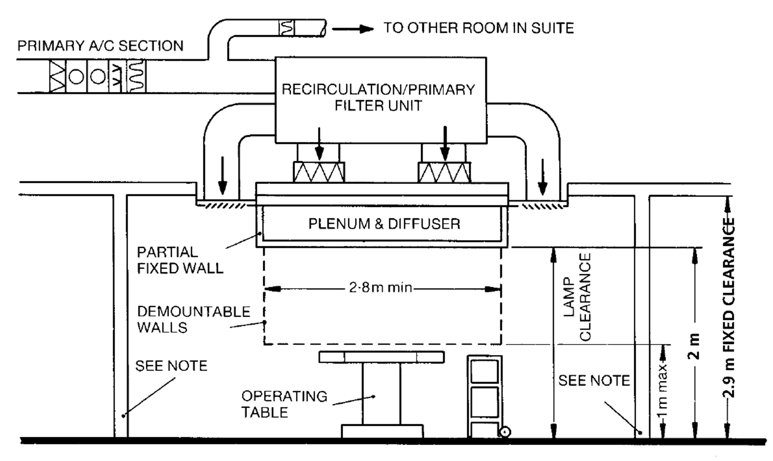
Reminder - UCV
Very clean air under the canopy (“plenum & diffuser”) - contamination both excluded and rapidly removed.
18

Slide 19
Instruments and UCV
If most airborne contaminants get into surgical wound via instruments in conventional ventilation, that effect is even greater if the wound is in UCV air but the instruments prepared in conventional ventilation.
The prep room to a UCV theatre has conventional ventilation.
Makes sense either to install horizontal UCV cabinet in prep room to UCV theatre, or to lay up under canopy
British Orthopaedic Association, Consultant Advisory Book (2014): “We strongly recommend that instrument trays should be prepared in an UCA [ultraclean air] environment”.
19

Slide 20
Laying up instruments in ultraclean zone
20

Slide 21
In the 1970/80s
Work by Owen Lidwell showed (BMJ 1982 285 10-14) a definite protective effect in total hip replacement (THR) and total knee replacement (TKR)
Infection rates: 1.5% in conventional and 0.6% in ultraclean
So, cleaner air equates with fewer infections – makes perfect sense
98% UK hip & knee arthroplasties now done in ultraclean ventilation (so any control group lost)
21

Slide 22
Why is nothing straightforward?
The keeping of national registers of surgical infection has enabled large-scale but crude analysis.
The data are dirty but the numbers are large
Other countries still use both conventional and ultraclean for orthopaedic surgical procedures
22

Slide 23
New Zealand
Hooper (2011) J Bone & Joint Surg (Br) 93 B; 85-90
Looked at 51,485 1^{ry} THRs and 36,826 1^{ry} TKRs
Deep infection rates (%) | THR | TKR
Ultraclean | 0.148 | 0.193
Conventional | 0.061 | 0.100
23

Slide 24
Germany
Brandt (2008) Ann Surg; 248: 695–700
Looked at 28,623 THRs and 9,396 TKRs
Deep infection rates (%) | THR | TKR
Ultraclean | 1.37 | 0.918
Conventional | 0.903 | 0.646
24

Slide 25
Review and guideline
Bishoff et al. Lancet ID, (2017) 17; 553-61
“The available evidence shows no benefit for laminar airflow compared with conventional turbulent ventilation of the operating room in reducing the risk of SSIs in total hip and knee arthroplasties”
WHO Global Guidelines for the Prevention of Surgical Site Infection (2016)
“The panel suggests that laminar airflow ventilation systems should not be used to reduce the risk of SSI for patients undergoing total arthroplasty surgery. (Conditional recommendation, low to very low quality of evidence)”
25

Slide 26
What’s going on?
Why does cleaner air equate with more infection?
No-one knows.
Lots of possibilities but likely to be a number of factors – not amenable to investigation as such.
26

Slide 27
What do we do?
Not a lot.
No UK comparative observation possible (no control group)
British Orthopaedic Association, Consultant Advisory Book (2014):
“1.2.7.2 Clean Air and Ventilation Systems: Ultraclean air (UCA) vertical laminar flow systems or equivalent are mandatory for joint replacements and major orthopaedic implant surgery”
We can only observe a) what data other countries produce, b) what guidelines arise and c) what UK professional bodies recommend.
27

Slide 28
Questions?
28

