Slide 1
Introduction of a Surgical Site Infection Surveillance Team and Dissemination of Data Resulting in Improved Patient Outcomes
Vanessa Whatley
Head of Nursing
Royal Wolverhampton NHS Trust

Slide 2
Session Objectives
Present one NHS Trust’s rational for large scale surgical site infection (SSI) surveillance.
Explain one approach to large scale SSI surveillance
Convey the practical implementation, evolution, challenges and sustainability of a project to implement high quality surgical site infection as a patient safety initiative.
Understand the potential impact of SSI surveillance.

Slide 3
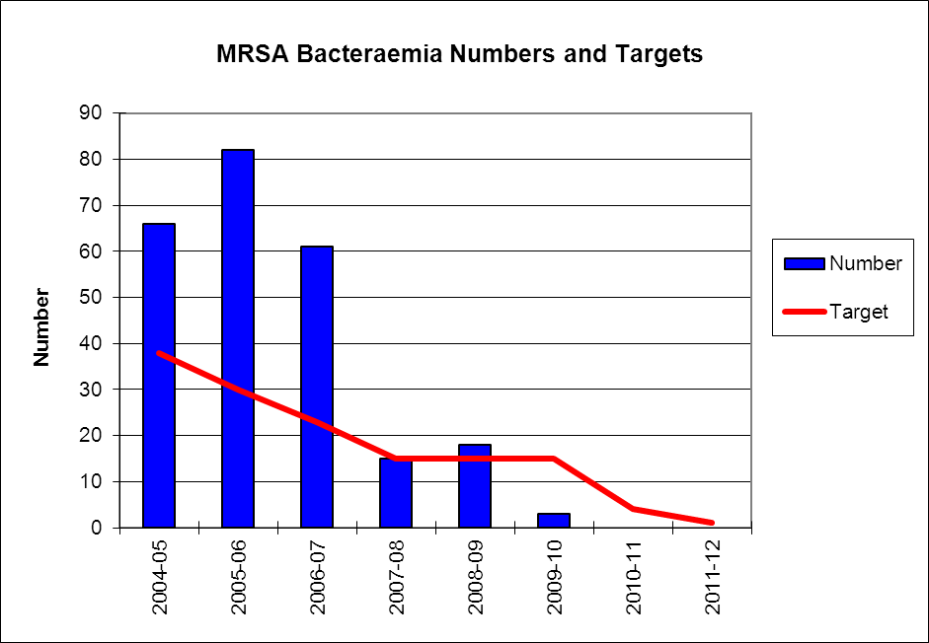
Background

Slide 4
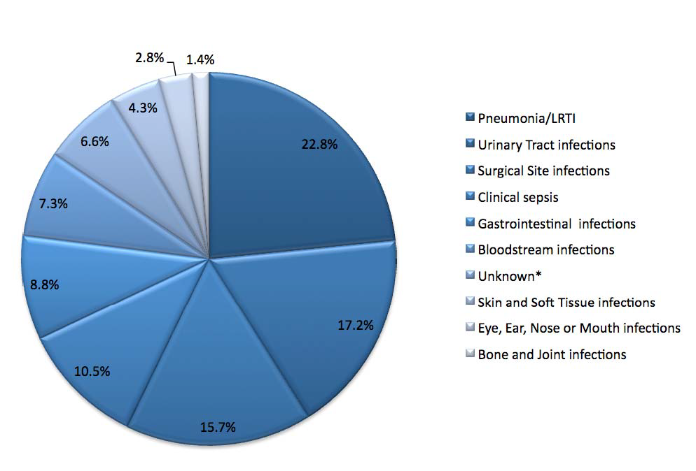
National Point Prevalence Survey 2011

Slide 5
SSI Trust Position April 2012
Surgical site infection surveillance compliant with mandatory requirement (orthopaedics)
CABG SSI surveillance consistent since development of new cardiac surgery service in 2005
Some local data collection by surgical teams
Surgeon preference for skin preparation product
Ambition to understand local burden of SSI and necessary actions to reduce it and improve aspect of patient safety.
Board seeking ‘what else’ for infection prevention.
“The Department’s approach to mandatory national surveillance means there is still no grip on surgical site infections. Progress is being hit by a lack of decent data.”
House of Commons Public Accounts Committee: Reducing Healthcare Associated Infection in Hospitals in England, 2009

Slide 6
Pre-project Data
In 2011/12 there had been 103 readmissions recorded as Post Op wound infection with the specific diagnosis code – T814 (HRG Primary code) and 217 with the code recorded as an inpatient in the same admission as the surgery.
14/17 patients readmitted returned to theatre in Sept 2012 due to SSI (82% of SSI readmissions)
12/13 inpatients returned to theatre in Sept 2012 due to SSI (92.3% of SSI inpatients)
312 bed days lost due to SSI in Sept 2012
10% chronic wounds (>6 weeks) origin in W’ton was a surgical site (local audit data).

Slide 7
Surgical Site Infection
Estimated to cost the NHS £700 million per year.
Plowman R et al.;1999;The socio-economic burden of hospital acquired infection. London: PHLS
3rd most common HCAI, (15.7%).
HPA; 2012; English national point prevalence survey; online: www.hpa.org.uk
The nationally estimated minimum infection rate is ‘at least 5%’.
NICE; 2008; Surgical site infection Prevention and treatment of surgical site infection Guideline CG74
Based on a 5% infection rate amongst 10,000 surgical procedures and an average cost per case of £3,500; 500 infections will cost a trust £1,750,000 in direct treatment of the patient, extended stay and readmissions.

Slide 8
How accurate is this?
Plowman data was collected in the 1990’s
Few NHS Trusts collect large scale high quality data SSI data Tanner et al; 2013; JHI. Wilson; 2013; JIP; 14:1
Post discharge surveillance is rarely collected
Assumptions are made on cost of inpatient stays, patient level data is new
Difficult to define where the costs come out
Costs vary throughout NHS and may be only relate to hospital episodes.

Slide 9
Project Objectives
Establish a system to undertake large scale, robust surgical site infection surveillance to provide a baseline SSI rate
Analyse and report SSI surveillance data and describe trends in infection rates pre and post intervention
Provide timely feedback of SSI rates to assist surgical teams in minimising the occurrence of SSI
Identify the burden of readmission due to SSI
Identify burden of community burden associated with SSI.

Slide 10
Business Case - Sept 2012
Existing resources used
Infection Prevention Team supervision (band 7)/ leave cover for band 6 nurse
Infection Prevention secretarial and data analysis resource
Infection Prevention senior leadership

Slide 11
Surveillance Methodology
National surveillance definitions were used (HPA; 2011; Protocol for the Surveillance of Surgical Site Infection)
Inpatient surveillance
  Readmission
  Day surgery (from July 2014-July2017)
Post discharge
  30 days telephone calls
  In addition 3 monthly for all implants for 1 year
  Clinic FU appointments
  Fracture clinic
  Surgical wound clinics
  Now surveying all atrial graft and implants indefinitely due to M. Chimaera through lab data
Exceptions
  Procedures involving mucous membranes e.g. TOE, endoscopy.
  Procedures not undertaken in theatres.
  Minor ops in GP practices.
  Day cases (Commenced April 15)
  Presentation
  Admission, Readmission, post discharge and patient reported
  Surgeon specific, specialty, microbial, wound type, microbiology, contrast with peers

Slide 12
Process
Patients identified through an interface with the Trusts Theatre system (Galaxy/Ormis)
Visited by an HCA for triggers
If positive visited by Nurse, discusses with clinical team and definitions applied
Post discharge surveillance call at 30 days (implants- call at 3, 6 and 12 months)
PD Questionnaire for positive SSI responses
Patients are ‘tagged’ on ICNet (SSI Monitor) for 1 year to alert on readmission.
All data stored on ICNet

Slide 15
Results

Slide 16
Summary Comparison
Inpatient, re-admission and post-discharge SSI rate for each surgical category are reported below (Q3 12/13 compared to Q1 18/19).
 | Q3 12/13 | Q1 18/19
General Surgery | 11.4 | 2.7%
Urology | 0 | 3.7%
Trauma | 4.7 | 0.8%
Orthopaedic | 4.7 | 1.5%
Gynaecology | 11.8 | 2.4%
Obstetrics | 11.6 | 1.5
Cardiothoracic | 14.1 | 3.9

Slide 17
Wound Categorisation Comparison

Slide 18
Patient Feedback
“Excellent to receive a surveillance call”
“Thank you so much, it’s very reassuring to have a call to see how I'm healing!”
“It’s nice to receive a follow up call”

Slide 19
Limitations
Data isn't risk stratified (sex, BMI, ASA, duration of operation T-Time) and is provided in an non-stratified form with a plan to include this in the future.
Procedures outside theatre are increasing but not currently included.
At times contingency plans have been put in place due to interface/IT issues which may result in some loss of information.

Slide 20
Positive Outcomes
Continued reduction in SSI rates since introduction
Enhanced working relationships within the Surgical Division
Competitive improvement strategy – anonymised surgeon data
Positively showcasing the Organisation
Excellent patient feedback
Data used to guide further improvement – MSSA screening and decolonisation pilot within Cardiac services as a response to SSI data
One together award winner for reducing SSI
Now substantive role of the IP team.
Supports GIRFT

Slide 21
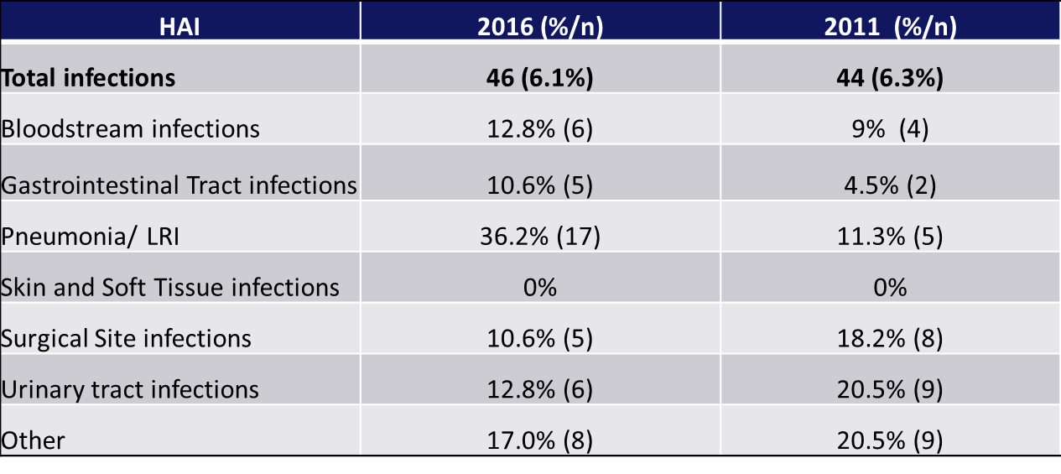
HAI Prevalence 2011 & 2016 Comparison
Nationally SSI remains at around 15% - PHE 2017

Slide 22
Conclusion and Next Steps
Outputs of sharing of data and information:
Next steps
Improved patient outcomes
Cost savings for the organisation
Assurance of compliance with NICE guidance
Reduce potential for AMR
Exploration of enhanced surveillance within Primary Care
Include risk stratification in the data
Plan for qualitative study- patients experience of SSI
What is the irreducible minimum?

Slide 23
References
Brown, B., Tanner, J. and Padley, W. (2014) '‘This wound has spoilt everything’: emotional capital and the experience of surgical site infections', Sociology of Health & Illness, 36(8), pp. 1171-1187. doi: 10.1111/1467-9566.12160.
Jenks, P.J., Laurent, M., McQuarry, S. and Watkins, R. (2013) 'Clinical and economic burden of surgical site infection (SSI) and predicted financial consequences of elimination of SSI from an English hospital', Journal of Hospital Infection, 86(1), pp. 24-33. doi: 10.1016/j.jhin.2013.09.012.
Leaper, D.J., Tanner, J., Kiernan, M., Assadian, O. and Edmiston, C.E. (2015) 'Surgical site infection: poor compliance with guidelines and care bundles', International Wound Journal, 12(3), pp. 357-362. doi: 10.1111/iwj.12243.
National Institute for Health and Care Excellence (2017) Surgical site infections: prevention and treatment. Available at: https://www.nice.org.uk/guidance/cg74 (Accessed: 29th April 2018).
National Institute of Health and Care Excellence (2013) Surgical Site infection Quality Standard [QS49]. Available at: https://www.nice.org.uk/guidance/qs49 (Accessed: 29th April 2018).
Tanner, J., Padley, W., Davey, S., Murphy, K. and Brown, B. (2012) 'Patient narratives of surgical site infection: implications for practice', Journal of Hospital Infection, 83(1), pp. 41-45. doi: 10.1016/j.jhin.2012.07.025.

Slide 24
Thank you

