Slide 1
The Photo at Discharge Project
Melissa Rochon
Quality & Safety Lead for Surveillance
Royal Brompton & Harefield NHS Foundation Trust
2017 Gold Impact Award & Overall Winner

Slide 2
Overview
Surgical site infection (SSI) cardiac surgery
Photo at Discharge (PaD) Scheme
Rationale
Feedback
Outcomes
Conclusion
2017 Gold Impact Award & Overall Winner

Slide 3
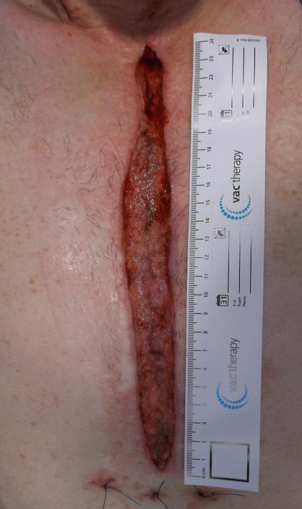
The Patient
Cardiac SSI
Mental: “The experience of [of an organ/space SSI] is changing who I am. There is a huge financial strain on me and my family from my being in hospital for months…the stress is very difficult to cope with”
Physical: removal of sternum, part of breast (sub-mammary infection)
Emotional: suffering

Slide 4
Photo at Discharge
Project Context: Reducing Avoidable Non-Elective Bed Days for Readmissions SSI
Evaluation
Cost Effectiveness, data from two sources (quality improvement project and propensity score matched data)

Slide 5
SSI are a leading cause of <30 day readmissions
RBHT Cardiac SSI*Readmissions
391 Non-elective Bed Days used, per annum
£533,300 spent on average, per year (net loss)
£488,000 in capacity lost a year to non-elective admissions for cardiac SSI
*Lower than benchmark: CABG Public Health England Jan08-Dec12, RBHT SSI Risk 4.1% vs All Hospitals SSI Risk 7.1%

Slide 7
This high proportion is largely due to:
The time it takes for bacteria to elicit host response
Delay in treatment
Compounded by fragmented communication/ information between acute and community care (Clinton and Obama, 2006)
Early detection: critical in reducing the severity and duration of SSI

Slide 8
Standard Communication to Community

Slide 9
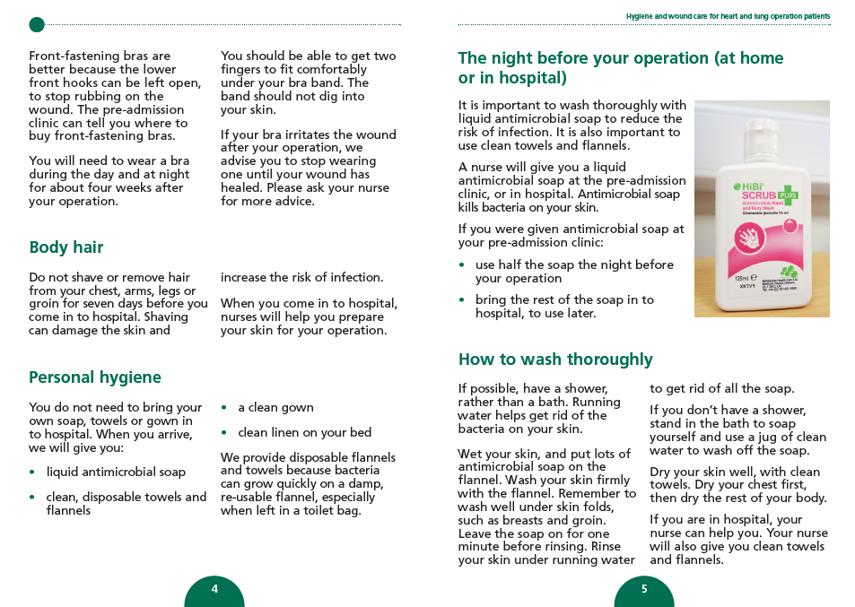
Generic Information to Patients & Carers
Check your wounds regularly to make sure they are healing well. Look out for changes that may need treatment.
wound looks red or angry
heat/swelling around a wound
more pain from a wound
pus or more fluid leaking from a wound
an unpleasant smell from a wound
any new opening of the wound

Slide 10
This is a form of patient-centred discharge information (PCDI) which Coleman et al. (2004) describe as having the explicit purpose of engaging patient responsibility and use during the transition of care. BUT…. A systematic review by Hansen et al. (2011) examined interventions to reduce all cause readmission to hospital within 30 days. The authors identified twelve studies which included interventions of PCDI. No intervention demonstrated a statistically significant reduction of readmission rates within 30 days (Hansen et al. 2011) Lack of evidence for patient education in SSI identification
Improve Patient Experience & Support Self-Care

Slide 11
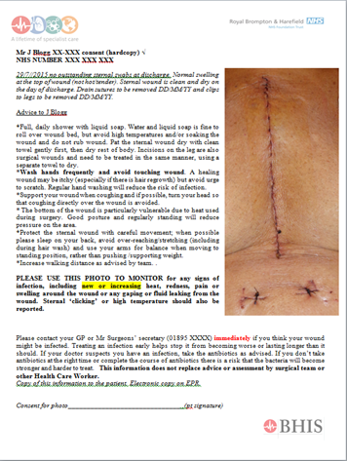
Patient-centred
Link between acute and community care
Low cost, practical tool

Slide 12
Simple Tool
Information on pre-existing skin appearance (dependent rubor, normal discolouration of healing process or venous states changes)
Baseline as to whether the wound is improving or deteriorating
2017/19 Wound assessment CQUIN
Overtreatment reduced with photos
↓ 48% to 16% (p < 0.001) (Sanger et al, 2016)

Slide 13
Patient Feedback
This is a value-based wound care approach, for the prevention and early intervention and optimisation of care for the patient and healthcare system
Main Themes from anonymised postal questionnaires
Compare and observe healing over time, providing reassurance
To enable patient to care for their own wound with confidence
Prompted review +/- treatment of concern
Other Themes
To provide aftercare / reference point for GP / nurse
Reassurance family / friends
Grateful to see how far they have come/journey
To help GP / nurses with providing treatment
Community staff impressed with new initiative
Better view of wound

Slide 14
100% Nurses
100% Consultants
100% SpRs
95% GPs
86% Patients
PaD is Useful
GP: ‘A positive, progressive step. Will provide the patient with reassurance with ongoing management, and useful for clinicians when reviewing the wound’
Registered audit, CIRIS Project ID:002197 Service Evaluation

Slide 15
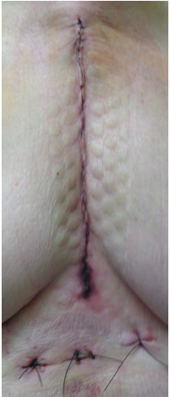
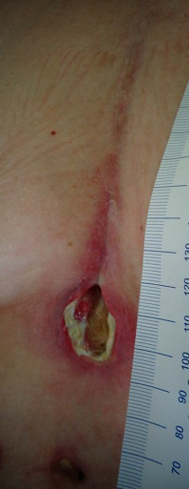
‘Watertight’ Incision

Slide 16
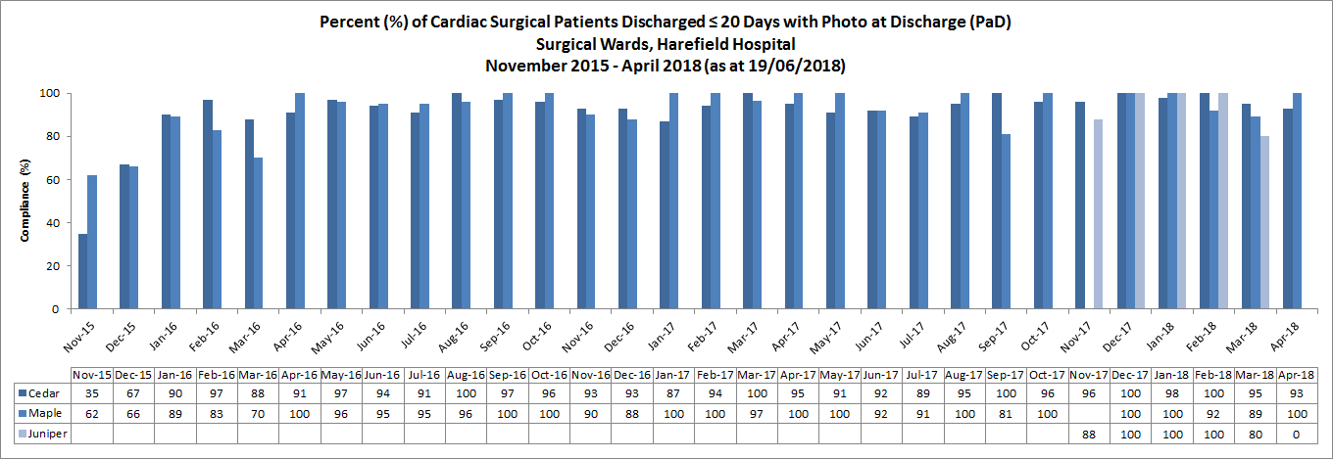
> 93% compliance

Slide 18
Data provided by Public Health England Jan 2009 – Dec 2017
Crown copyright 2018, contains public sector information licensed under the Open Government Licence v3.0.

Slide 19
Data provided by Public Health England Jan 2011 – Dec 2017
Crown copyright 2018, contains public sector information licensed under the Open Government Licence v3.0.

Slide 20
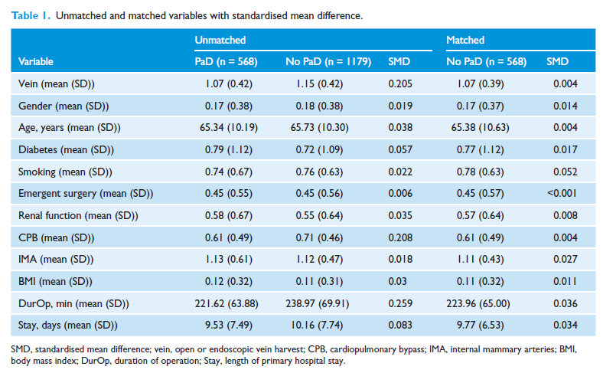

Slide 21
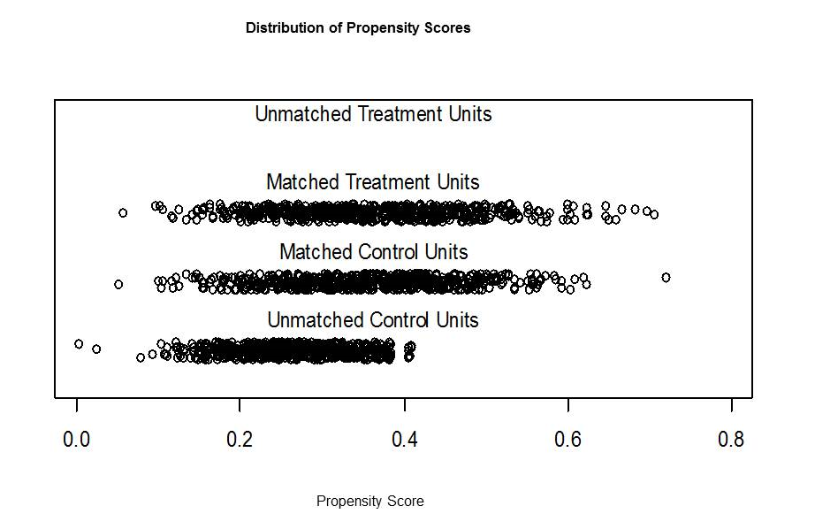
There was a significant difference in risk of readmission for SSI (relative risk = 0.2, 95% confidence interval [CI] = 0.04–0.91). This suggests that PaD reduced the risk of SSI readmission by 80% and that this was statistically significant (p = 0.037).

Slide 22
Cost Avoidance
‘Costs avoided’ by reducing SSI readmissions (based on running costs)
Absolute Risk Reduction of 80%
Propensity Case Score Matched (PCSM) Analysis (minimum) £133,948
Absolute Risk Reduction 86%
Non-matched Quality Improvement (QI) project (maximum) £221,539
Indirect costs excluded : incapacity to work (temporary or permanent), income lost by family members, lost leisure time, home care, travel costs (Dohmen, 2013) and years of productive life lost (latter exceed direct costs 8 times [Alfonso et al, 2007] and intangible costs excluded ie Trust reputation)

Slide 23
Capacity Released
By reducing readmissions for SSI….
313 cardiac surgical bed days released (PS)
Equivalent to one month ISO CABG activity
↑45 patients having CABG surgery
336 cardiac bed days released per year (QI)
↑ 48 patients having CABG surgery

Slide 24
Summary
For every £1 spent, the steady-state PaD scheme generates between £1,172 and £1,938 of benefits in ‘cost avoided’.
What our Clinicians Say “This is a very important tool…especially if there is an issue with the wound, we have something to compare. Helps us to decide how the treatment is working”. What our Patients Say “The photo, information and instructions …great! It gave a sense of security and eliminated worry while recovering.”

Slide 25
Thank you for listening
m.rochon@rbht.nhs.uk

